Slide 1
Analog and RF CMOS circuit design
Design of a fully integrated wireless power transmitter
Alexandre Boyer, Sonia Ben Dhia
alexandre.boyer@insa-toulouse.fr
www.alexandre-boyer.fr
2017-2018

Slide 2
Presentation of the project
Project based learning
Intended learning outcomes:
List of learning outcomes | Level
Know the fundamental building blocks used in analog, RF and digital circuits | Knowledge & comprenhension
Understand their operation | Comprehension
Specify the electronic architecture of an integrated circuit from specifications | Application
Use CAD tools to develop and check the operation of CMOS IC project | Application
Analyze the influence of environmental and process effects on IC performance | Analysis
Propose and evaluate IC design solutions to respond to performance criteria | Synthesis & Evaluation
Notes:
2

Slide 3
Analog and RF circuit design: Context
Typical design flow of analog/RF IC (full custom)

Slide 4

Presentation of the project
Design of a fully integrated wireless power transmitter for small mobile devices (e.g. smartphone) in an automotive context
Fully integrated = all the functional blocks are embeded on the same die, the number of external components are limited as much as possible.
The transmitter must meet the requirements of the standard QI, developed by the Wireless Power Consortium (version WPC 1.1.2)
Principle of the operation:
(example: Freescale WCT1001A)

Slide 5

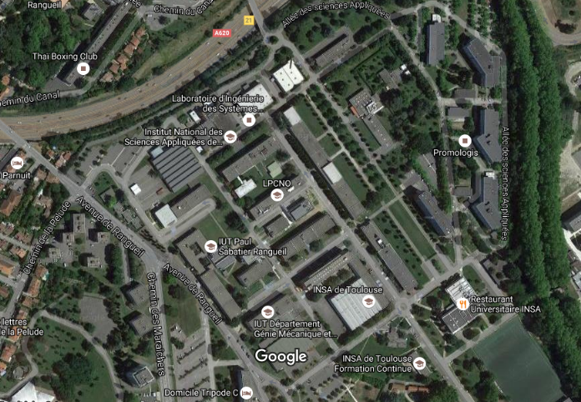

Presentation of the project
Design of a « Smart Power » circuit
Technology: ams High Voltage 50 V CMOS 0.35µm with 4 levels of métal (H35B4S1 process )
Use of design kit ams Hit kit 4.10 for 0.35µm CMOS Processes (C35/S35/H35), available at CAD platform of AIME
Use of CAD environment Cadence for validation and optimization of electrical schematic
SPICE simulation (SPECTRE)
Entrée CAO
Notes:
5

Slide 6
Presentation of the project
Main steps of the project:
  Design an architecture of the circuit (block diagram) with all the physical input-outputs
  Respect all the constraints (functional performances, electrical, environmental, technological constraints, etc.)
  Propose electrical diagram of some analog/RF blocks of the circuits with associated constraints
  Write a specifications report containing the previous information
  Validation and improvement of electrical schematic based on CAD tool (Cadence)
  Prediction of circuit performances in the different PVT conditions
  Write a design report (« scientific paper » format) which presents the designed circuit and simulated performances
Notes:
6

Slide 7
Presentation of the project
List of specifications in Analog_CMOS_Design_Project_2017-18.pdf
Link with English course.
List of documents available on www.alexandre-boyer.fr/enseignements.htm (link to courses, technological specifications, students reports)
Assessments by two written reports and a final presentation:
  Detailed circuit specification (Specification_report_WPT_GpeX_2016.doc) → Due before Friday 10/11/2017 at 23h59
  Design report (Fiche synthese English version.doc) → Due before Tuesday 09/01/2018 at 23h59
  Final presentations (during English course) → Wednesday 17/01/2018 afternoon

Slide 8
Design flowsheet
Project 1 – Presentation + Group work (spec.)
Project 7 – Feedback spec. report
Project 6 – Group work (Sch.)
Specification report delivery
Project 2 – Group work (Spec.)
Lab analog 1 – CAD tool initiation (starting exercise)
Lab analog 2 - 6
Project 3– Feedback for IC block diagram and I/O list
Project 5– Student generated question + quizz
Project 8 – Feedback design report
Design report
Project4– Group work (Sch.)
Final presentation
Group work
Lab
Feedback from the teacher
Report delivery and presentation

Slide 9
Teams
Group 1 | Group 2 | Group 3
Mathieu BOUGEARD | Morgan BRUNEAU | Mohamed Yassir CHAOUAL
Yonggi CHOI | Alvaro Jorge DE MELO JUNIOR | Clément DECROUX
Samuel MAREK-FAVAREL | Francisco Danilo RODRIGUES SOARES | Yang SUN
Tran Tien VO | Hassna AMEUR | Humberto DE BRITO RANGEL NETO
Brahim MOKHTARI

